Slide 1
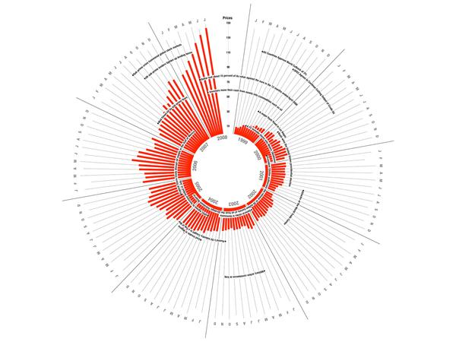
Data Visualization Interactivity

Slide 2


First… Create an Interactive Dashboard
Use US Energy Information Data
https://www.eia.gov/state/rankings/#/series
Use at least three data sets combined in Tableau
Dashboard should contain at least three parts
Apply filters
Filters should be enabled on all parts
Publish to Tableau Public
Refine if necessary and re-publish
View Dashboard online – use interactive tools
U.S. Energy Information Administration

Slide 3
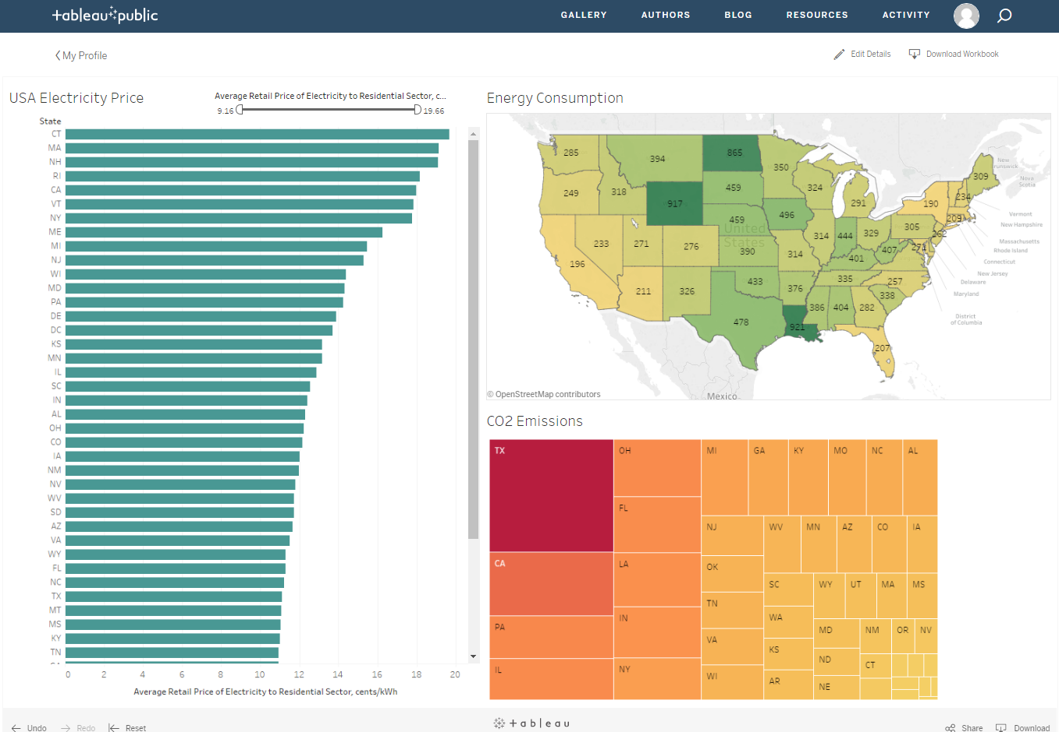
Tableau Public
Notes:
https://public.tableau.com/views/USAEnergyDashboard/Dashboard1?:embed=y&:display_count=yes

Slide 4
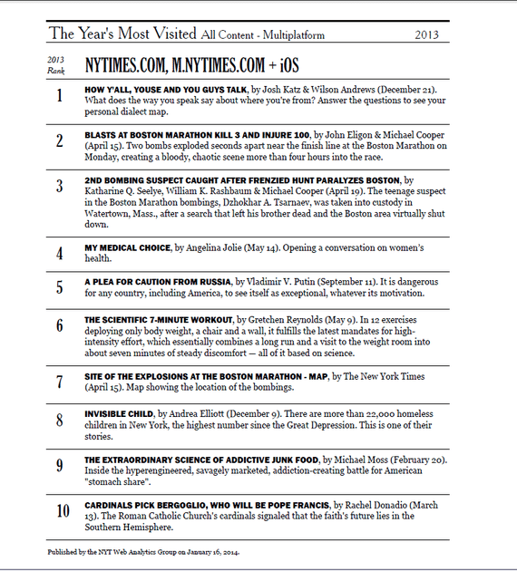
The New York Times' Most Popular Story of 2013 Was Not an Article
#1
How Y’all, Youse, and You Guys Talk
A news app, a piece of software about the news made by in-house developers, generated more clicks than any article
It took a news app only 11 days to “beat” every other story the Times published in 2013
Source: The Atlantic.
Notes:
https://www.theatlantic.com/technology/archive/2014/01/-em-the-new-york-times-em-most-popular-story-of-2013-was-not-an-article/283167/
Exercise: http://www.nytimes.com/interactive/2013/12/20/sunday-review/dialect-quiz-map.html?_r=0
What does the way you speak say about where you’re from? Answer all the questions below to see your personal dialect map.

Slide 5
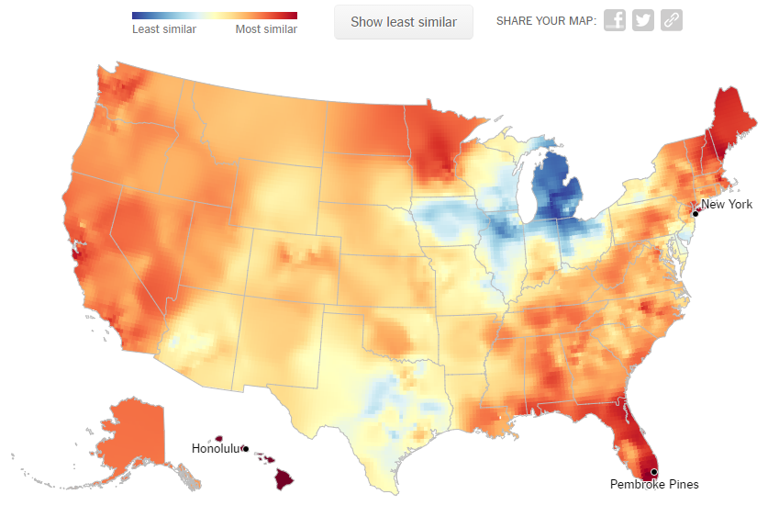
Eugene’s “Y’all” Map
See the pattern of dialect in the map
Quiz
Fun
Easy
Share
Notes:
Most similar to New York, Pembroke Pines, and Honolulu!
Exercise: http://www.nytimes.com/interactive/2013/12/20/sunday-review/dialect-quiz-map.html?_r=0
What does the way you speak say about where you’re from? Answer all the questions below to see your personal dialect map.

Slide 6

Interactivity
Expand physical limits of what you can show in a limited space
Increase quantities
Broaden variety
Facilitate manipulation of data
Facilitate interrogation of data
Increase control
Customize experience
Amplifies your creative licence
Allows different techniques for engaging users
Notes:
Kirk p223
Just because you can add interactivity does not mean that you should – it might not be helpful or required.

Slide 7
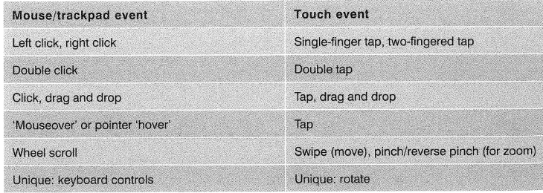
Organise Thinking
Two options:
Data adjustments: Affecting what data is displayed
Presentation adjustments: Affecting how the data is displayed
Consider
Event (input)
Control (eg: a button)
Function (filter)
Kirk (2016) p224

Slide 8

Five “Awesome” Interactive Data Visualizations
The Global Arms Trade from Google
Tech IPOs from the New York Times
Peoplemovin
Data Visualization: Journalism's Voyage West
The Evolution of the Web from Google
Source: https://www.nyi.net/5-awesome-interactive-data-visualizations/
Notes:
http://armsglobe.chromeexperiments.com/
http://www.nytimes.com/interactive/2012/05/17/business/dealbook/how-the-facebook-offering-compares.html?_r=0
http://www.peoplemov.in/
http://web.stanford.edu/group/ruralwest/cgi-bin/drupal/visualizations/us_newspapers
https://www.nyi.net/5-awesome-interactive-data-visualizations/

Slide 9
Data Adjustments
Influence what data are displayed at a given moment
Framing
Navigating
Animating
Sequencing

Slide 10
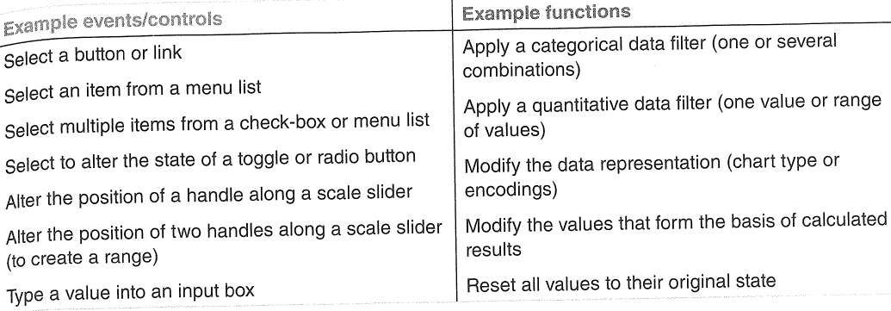
Framing
Decide which data to include or exclude
All category values or just a selection?
All quantitative values, or just those above a specific threshold?
All data or just those between a defined time interval?
Kirk (2016) p225
Notes:
Kirk (2016) p134

Slide 11
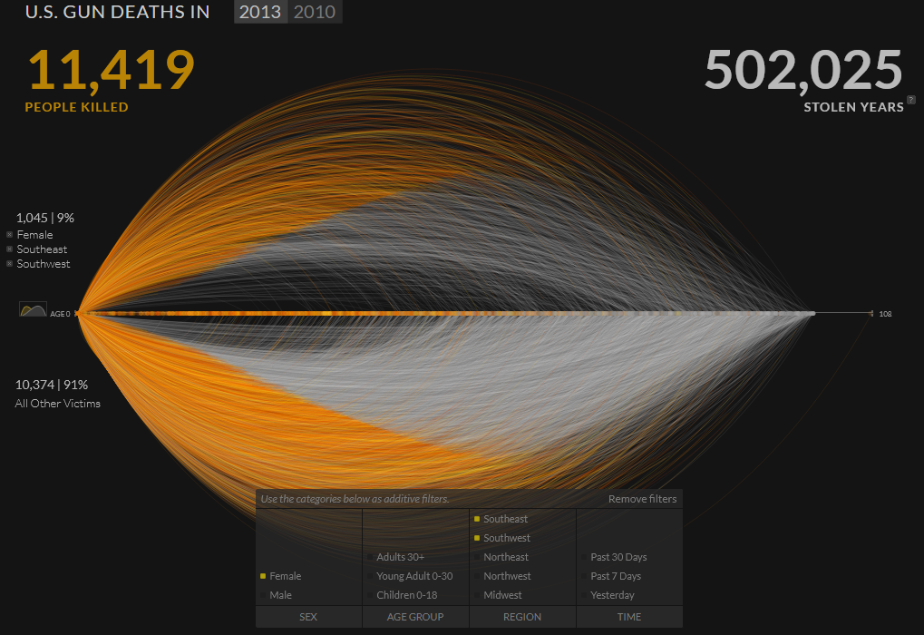
Framing – An Example
x
Source: http://guns.periscopic.com/?year=2013
Notes:
http://guns.periscopic.com/?year=2013
Go and explore it

Slide 12
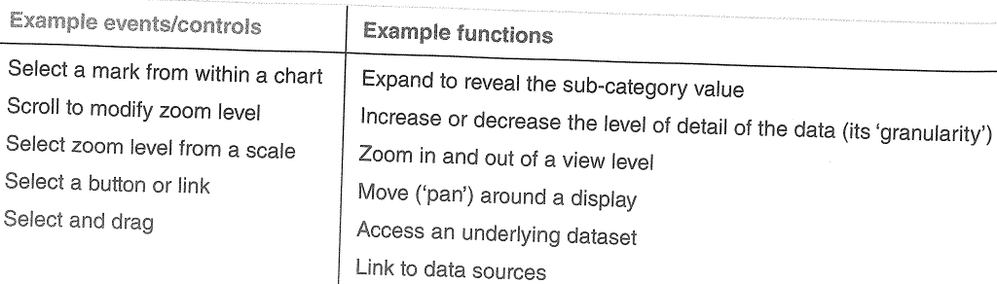
Navigating
Dynamic options that enable the viewers to expand or explore the displayed data
Consequence: there is a re-framing of data
Kirk (2016) p226

Slide 13
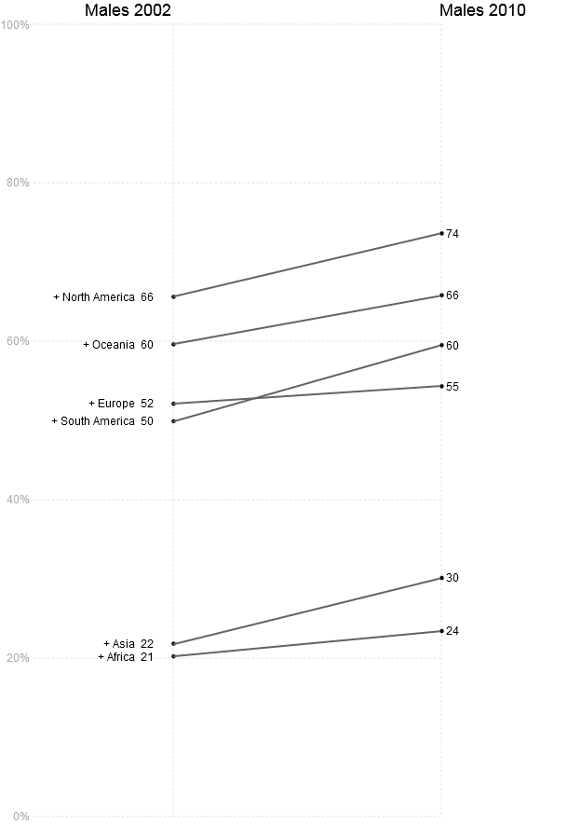
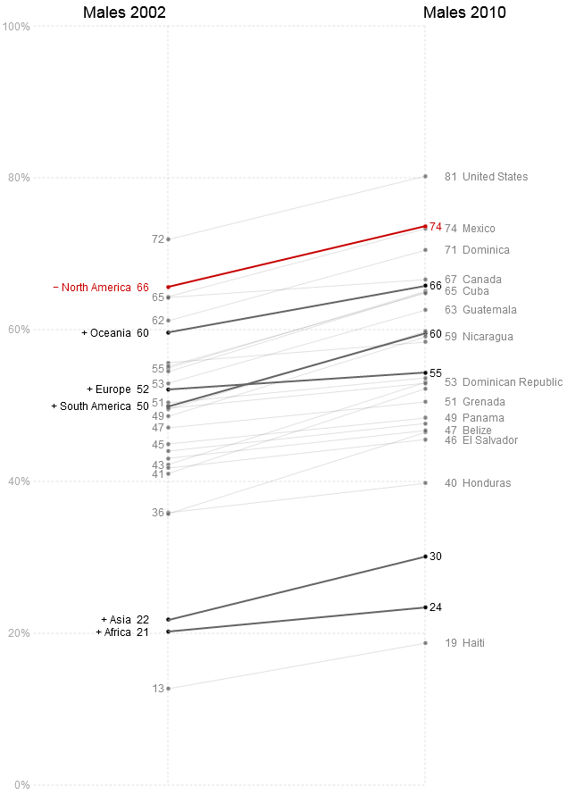
Explore the Data
x
Source: http://neoformix.com/Projects/ObesitySlope/
Notes:
Source: http://neoformix.com/Projects/ObesitySlope/

Slide 14
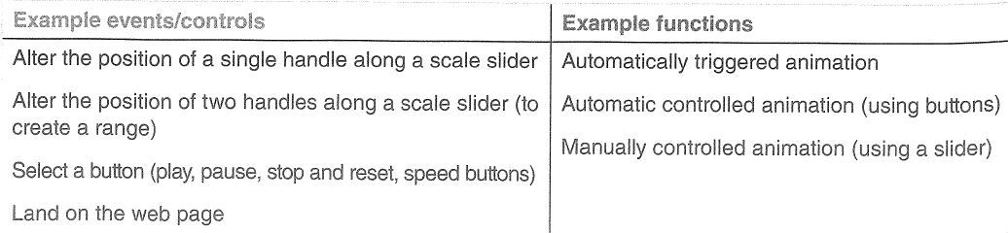
Animating
An animated sequence of visualisations of the same phenomena modifying over time
Suitable for temporal data
Data adjustment
Shifting of the timeframe - can be manual and/or automatic
Kirk (2016) p228

Slide 15
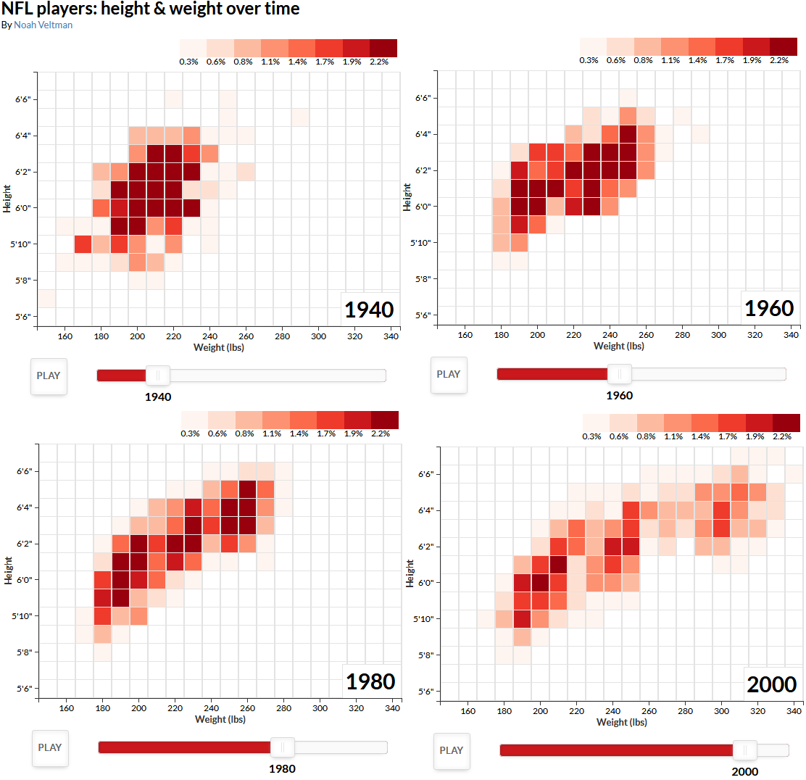
Animating
x
Source: http://noahveltman.com/nflplayers/
Notes:
Source: http://noahveltman.com/nflplayers/
Animated heat map

Slide 16
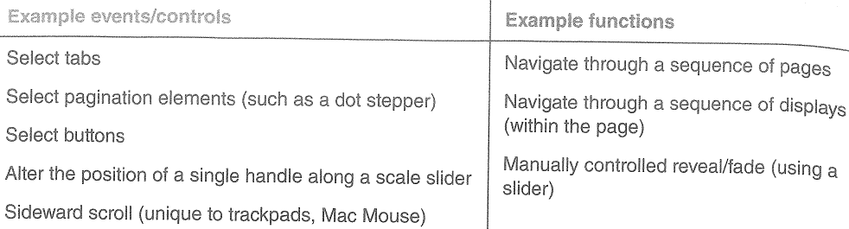
Sequencing
Viewers navigate through a sequence of predetermined, different angles of analysis of a subject
Kirk (2016) p230
Notes:
Builds a narrative

Slide 17
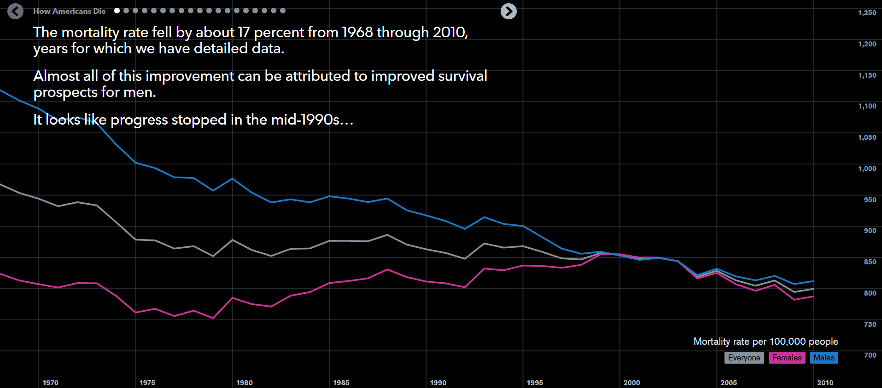
Sequencing
x
Source: “How Americans Die” by Matthew C. Klein and Bloomberg Visual Data
https://www.bloomberg.com/graphics/dataview/how-americans-die/
Notes:
Source: https://www.bloomberg.com/graphics/dataview/how-americans-die/

Slide 18

Sequencing – Another Example
Model Projections of Maximum Air Temperatures Near the Ocean and Land Surface
December 21, 2014
Source: https://earthobservatory.nasa.gov/IOTD/view.php?id=86027
Notes:
https://earthobservatory.nasa.gov/IOTD/view.php?id=86027
Bad example – the sequencing is too sudden

Slide 19

Sequencing – Another Example (cont.)
Model Projections of Maximum Air Temperatures Near the Ocean and Land Surface
December 21, 2099
Source: https://earthobservatory.nasa.gov/IOTD/view.php?id=86027
Notes:
https://earthobservatory.nasa.gov/IOTD/view.php?id=86027

Slide 20
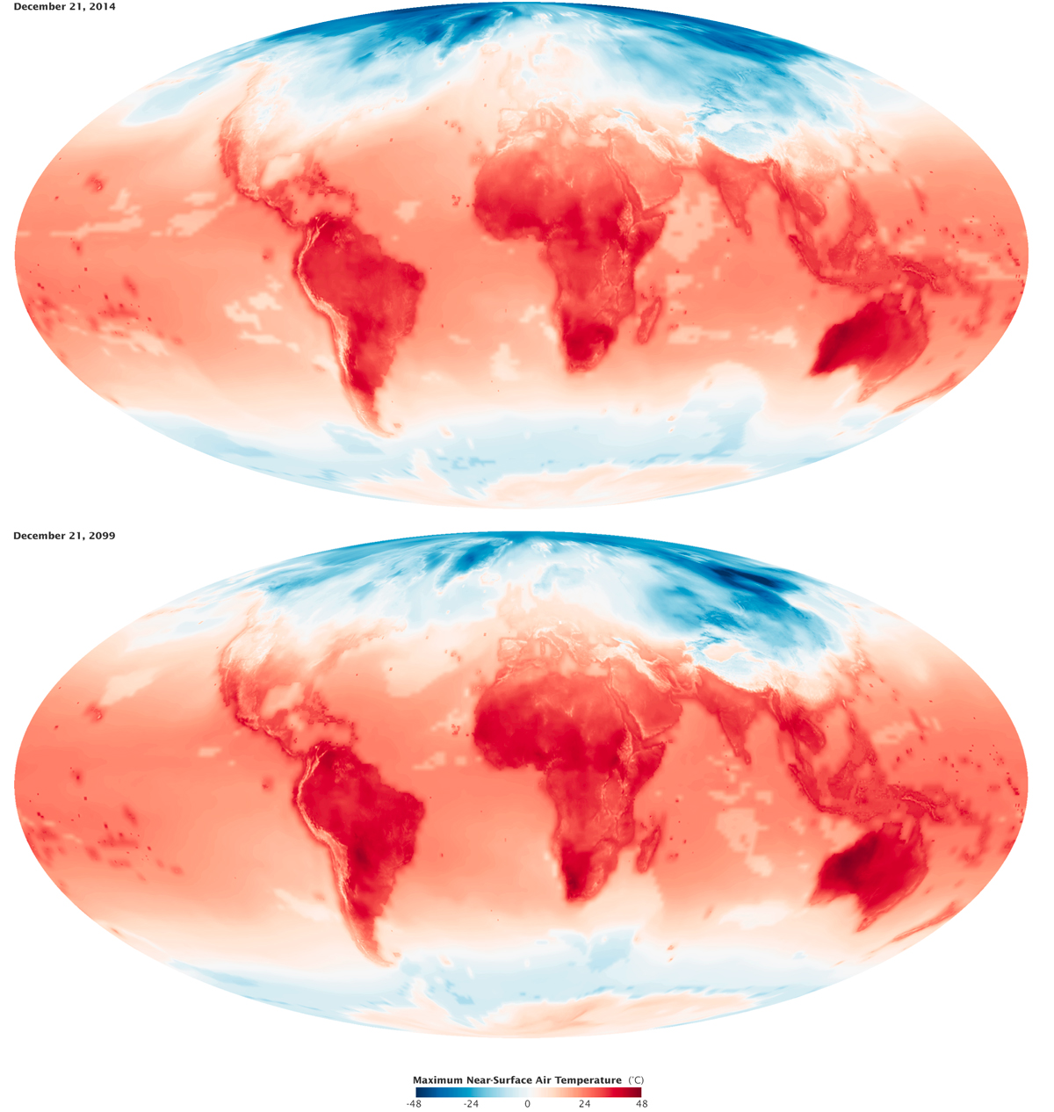
Sequencing – Before and After
Model Projections of Maximum Air Temperatures Near the Ocean and Land Surface
Source: https://earthobservatory.nasa.gov/IOTD/view.php?id=86027
Notes:
https://earthobservatory.nasa.gov/IOTD/view.php?id=86027

Slide 21
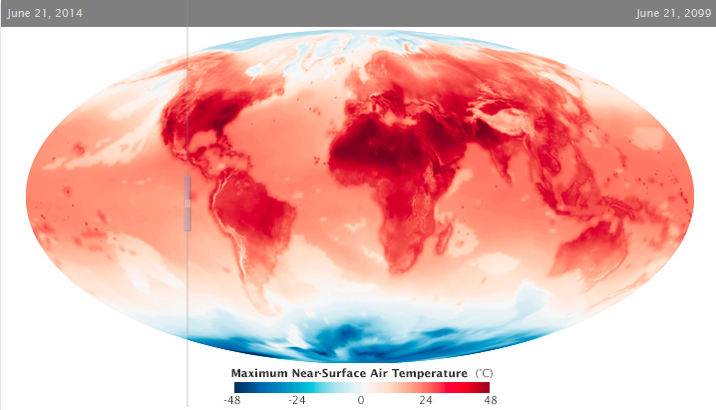
Sequencing – Before and After
Model Projections of Maximum Air Temperatures Near the Ocean and Land Surface
Source: https://earthobservatory.nasa.gov/IOTD/view.php?id=86027
Notes:
https://earthobservatory.nasa.gov/IOTD/view.php?id=86027

Slide 22




Vertical sequencing: Bryce Harper’s swing
Source: http://www.washingtonpost.com/wp-srv/special/sports/bryce-harper-swing-of-beauty
Notes:
Source: http://www.washingtonpost.com/wp-srv/special/sports/bryce-harper-swing-of-beauty

Slide 23
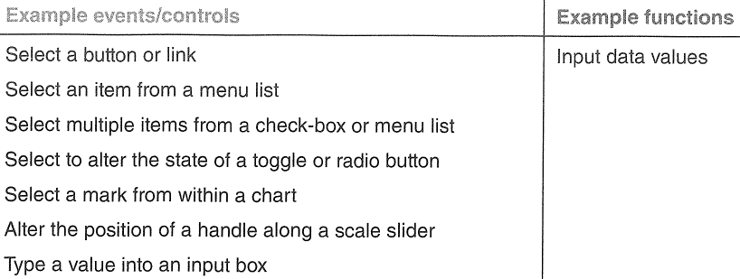
Contributing Data
User input to provide additional information
User input to inform calculations or customize a display
Kirk (2016) p232

Slide 24
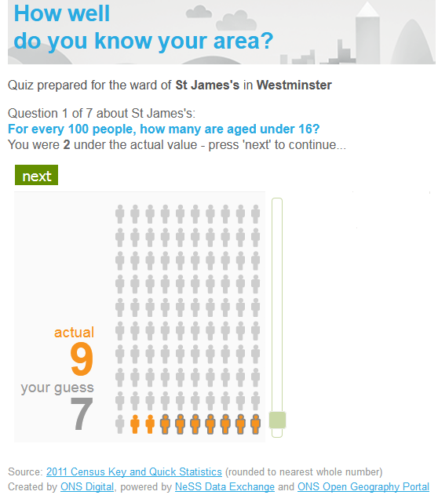
User Input – Quantitative Data
x
Source: http://www.neighbourhood.statistics.gov.uk/HTMLDocs/dvc147/
Notes:
http://www.neighbourhood.statistics.gov.uk/HTMLDocs/dvc147/
e.g. Downing Street, London, SW1A 2AA
Quiz/game
use the handle to modify the position along the slider

Slide 25
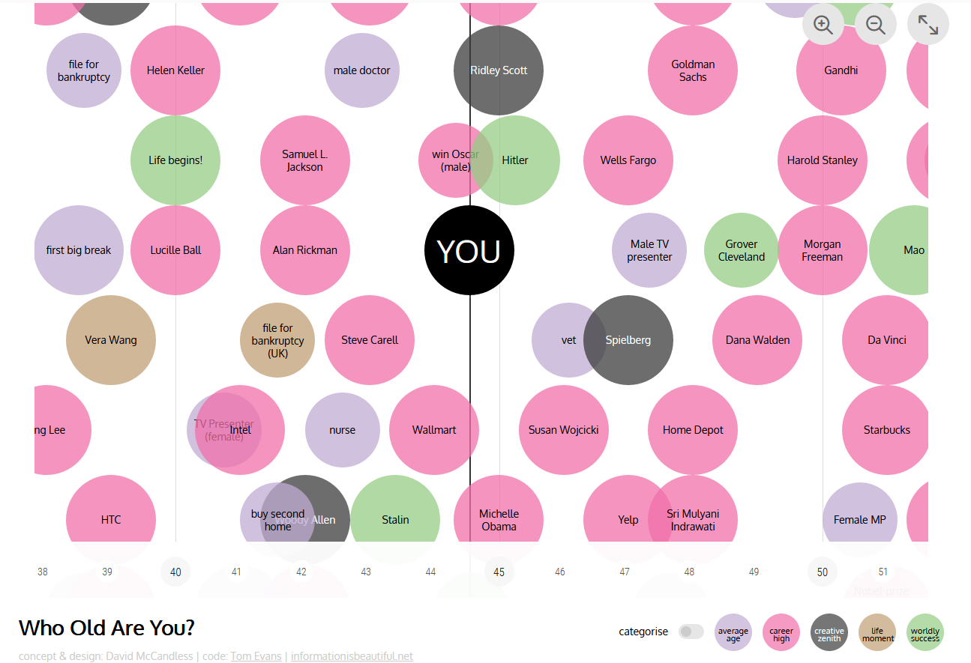
User Input – Inform Calculations and Display
x
Source: http://www.informationisbeautiful.net/visualizations/who-old-are-you/
Notes:
Source: http://www.informationisbeautiful.net/visualizations/who-old-are-you/
Uses input boxes
2 more examples follow

Slide 26
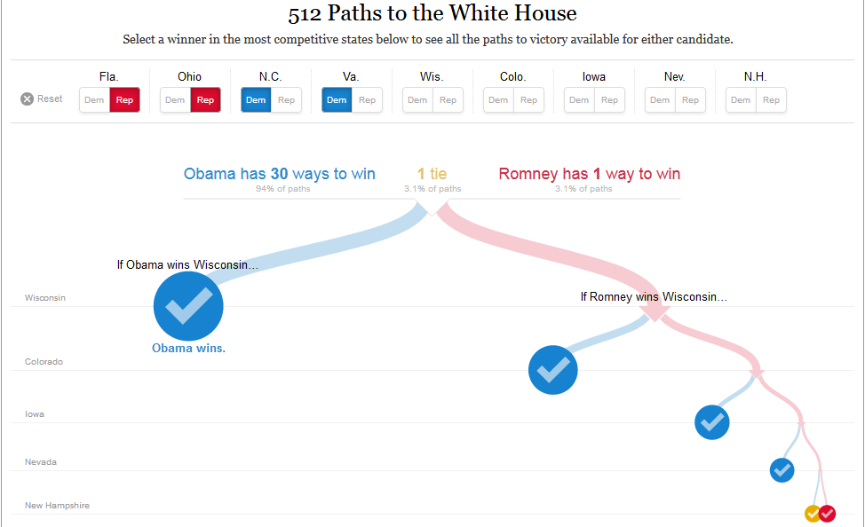
x
Source: http://www.nytimes.com/interactive/2012/11/02/us/politics/paths-to-the-white-house.html?_r=0
Notes:
Source: http://www.nytimes.com/interactive/2012/11/02/us/politics/paths-to-the-white-house.html?_r=0
Uses toggle buttons

Slide 27
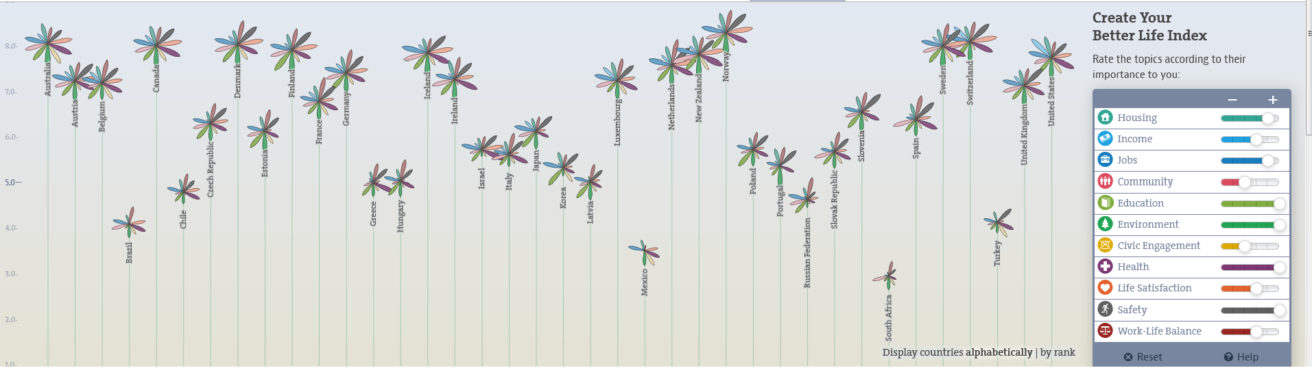
OECD Better Life Index
x
Source: http://www.oecdbetterlifeindex.org/#/11111111111
Notes:
OECD Better Life Index
http://www.oecdbetterlifeindex.org/#/11111111111

Slide 28
Presentation Adjustments
Influence how data are displayed at a given moment
Focusing
Annotating
Orientating

Slide 29
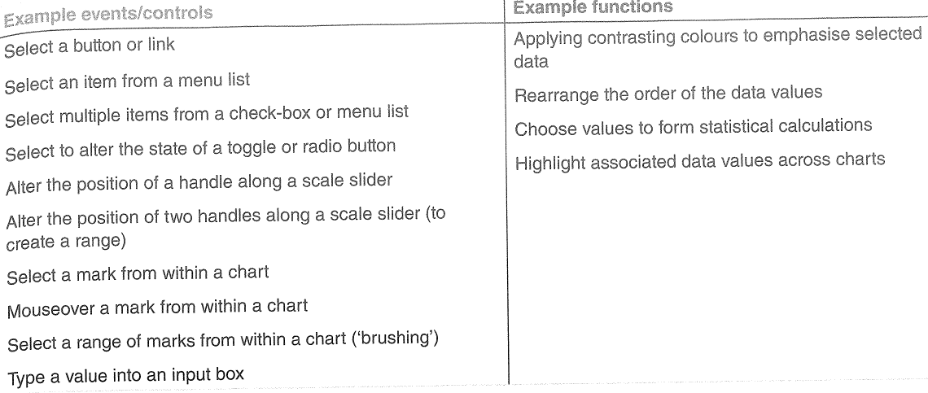
Focussing
Controls what data is visually emphasised, and how it is emphasised
Kirk (2016) p235

Slide 30
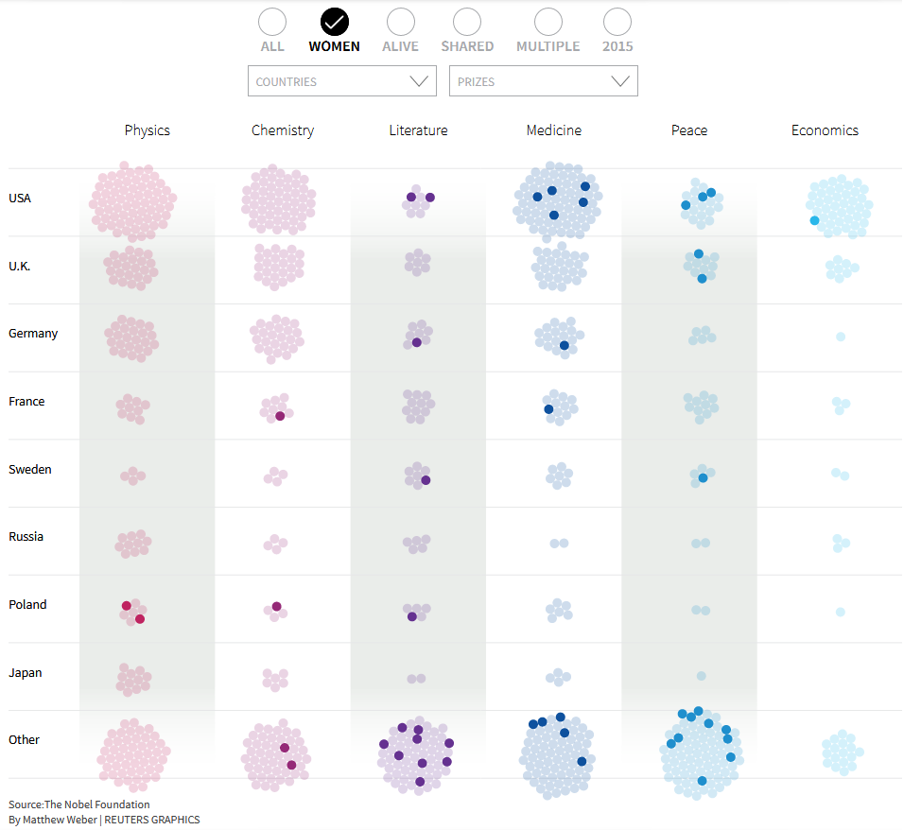
Focusing – Nobel Laureates Example
x
Source: http://graphics.thomsonreuters.com/15/nobels/
Notes:
Source: http://graphics.thomsonreuters.com/15/nobels/
Nobel Laureates

Slide 31
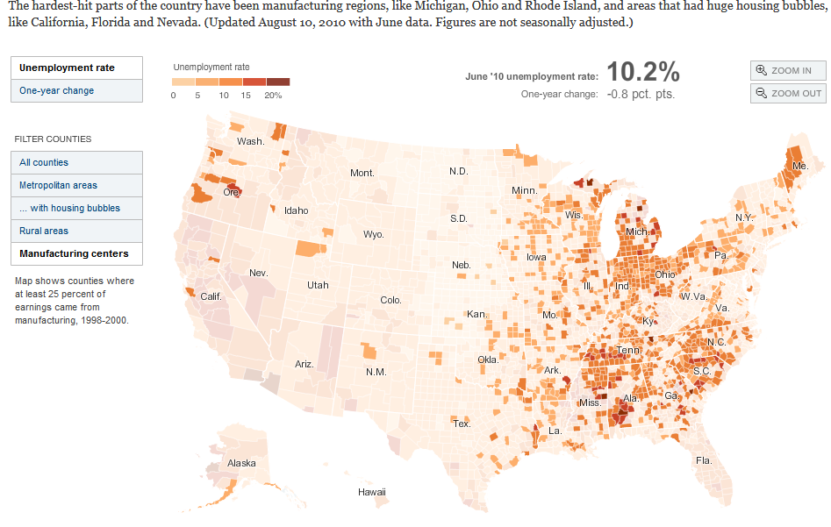
Geography of a Recession
x
Source: http://www.nytimes.com/interactive/2009/03/03/us/20090303_LEONHARDT.html?_r=1&
Notes:
Source: http://www.nytimes.com/interactive/2009/03/03/us/20090303_LEONHARDT.html?_r=1&

Slide 32
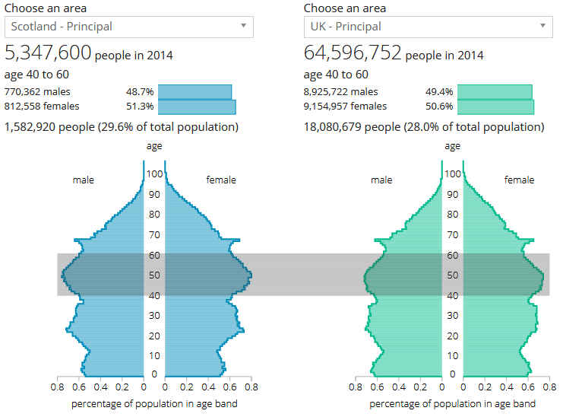
How Big Will UK Population be in 25 Years’ Time
x
Source: http://visual.ons.gov.uk/how-big-will-the-uk-population-be-in-25-years-time/
Notes:
Source: http://visual.ons.gov.uk/how-big-will-the-uk-population-be-in-25-years-time/

Slide 33
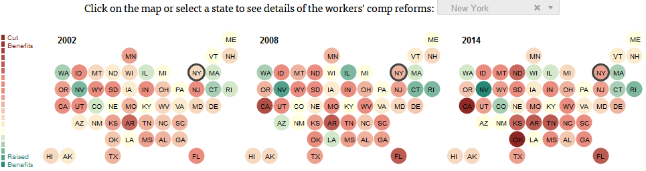
Worker’s Compensation Benefits by US State
x
Source: http://projects.propublica.org/graphics/workers-comp-reform-by-state?state=New_York
Notes:
Source: http://projects.propublica.org/graphics/workers-comp-reform-by-state?state=New_York

Slide 34
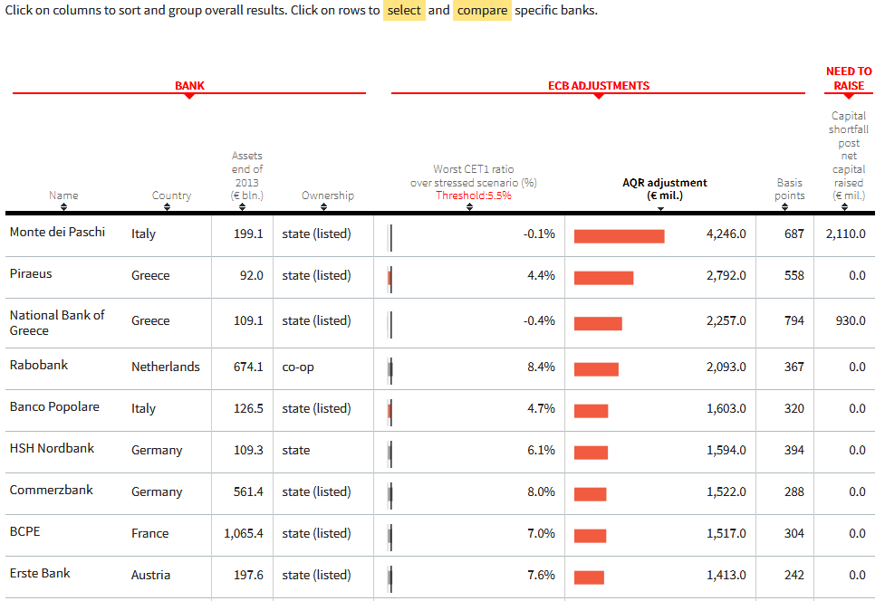
ECB Bank Test Results (a fragment)
x
Source: http://graphics.thomsonreuters.com/14/ecbtests/index.html
Notes:
Source: http://graphics.thomsonreuters.com/14/ecbtests/index.html

Slide 35
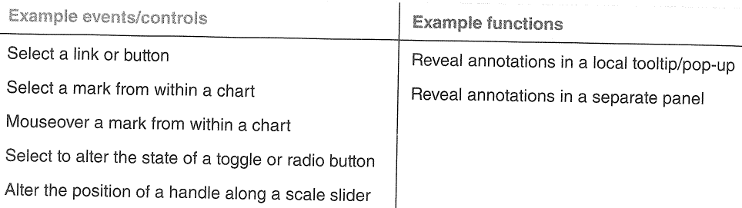
Annotating
Enables viewers to interact with the visualisation to view more details
Kirk (2016) p236

Slide 36
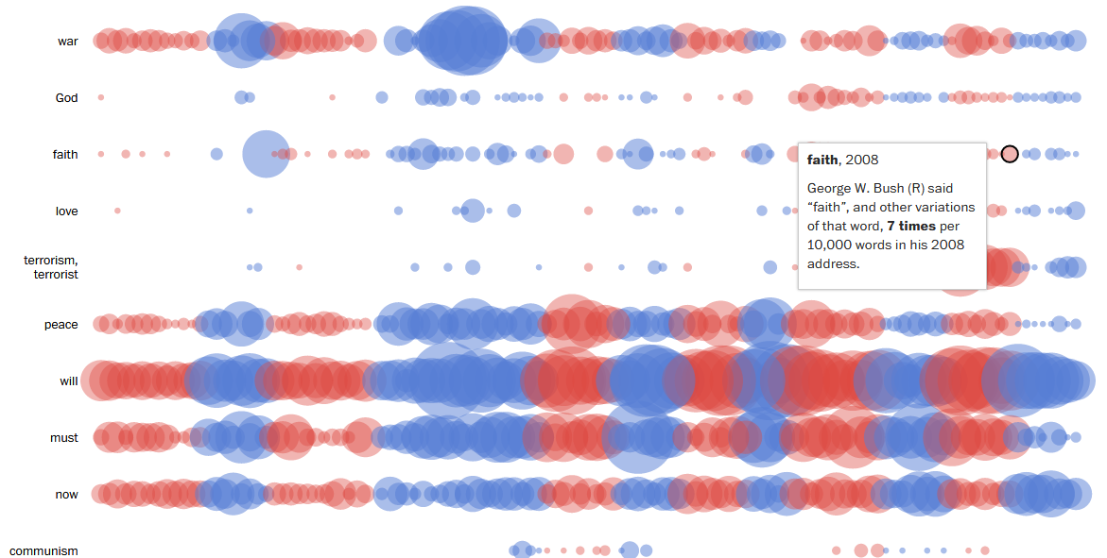
History through the President’s Words
x
Source: https://www.washingtonpost.com/graphics/politics/2016-sotu/language/
Notes:
“Rhetoric
The absence of “God” from earlier addresses surprised Fields, who said earlier references framed God as a “divine majesty,” but in later political rhetoric, God has been treated more like an old buddy, one who understands and likes us and one whom we like and understand.”
“Must” was a favorite rallying word of Franklin D. Roosevelt, who used his addresses to assert confidence and assured determination to the nation. The trend continued to blossom in subsequent decades.”
Source: https://www.washingtonpost.com/graphics/politics/2016-sotu/language/

Slide 37
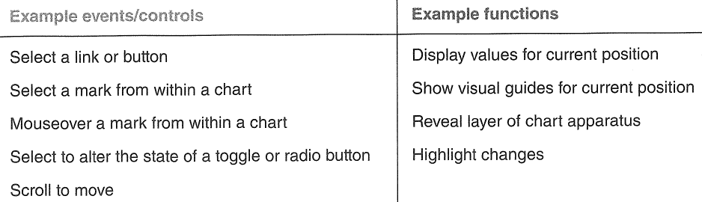
Orientating
Orientation elements to make a better sense of the position within a visualisation
Kirk (2016) p237

Slide 38
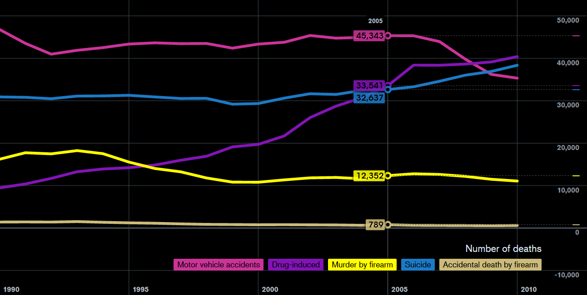
How Americans Die?
x
Source: https://www.bloomberg.com/graphics/dataview/how-americans-die/
Notes:
How do suicide and drugs compare to other violent deaths across the population?
Dynamically reveals the values of every mark (x and y values)

Slide 39
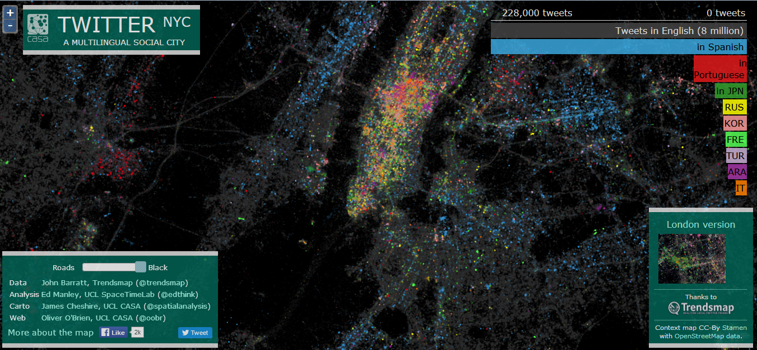
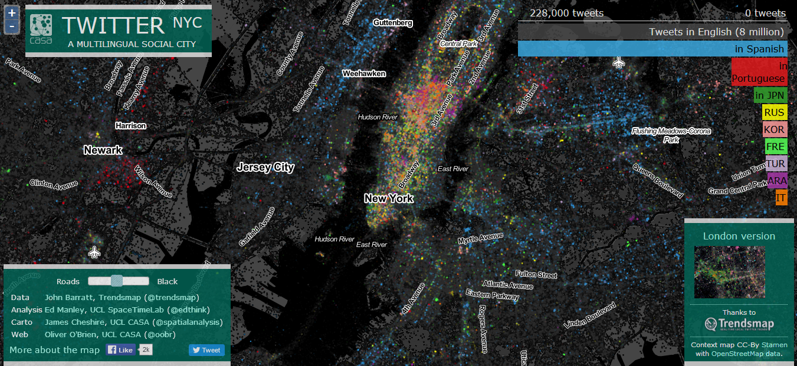
Twitter NYC: A Multilingual Social City
x
Source: http://ny.spatial.ly/

Slide 40
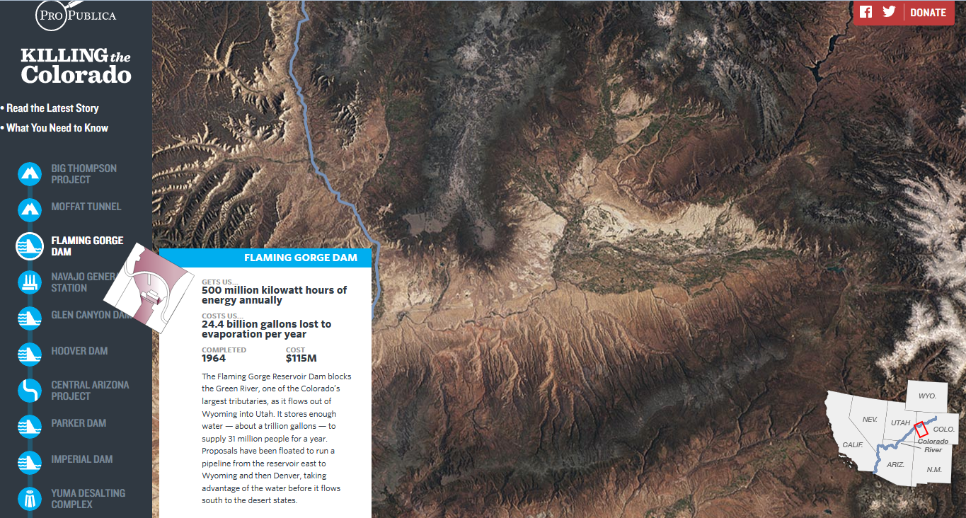
Killing the Colorado: Explore the Robot River
x
Source: https://projects.propublica.org/killing-the-colorado/explore-the-river#big-thompson-project
Notes:
Source: https://projects.propublica.org/killing-the-colorado/explore-the-river#big-thompson-project
Use a vertical landscape to follow the narrative – “ scrollytelling” Kirk (2016) p238

Slide 41
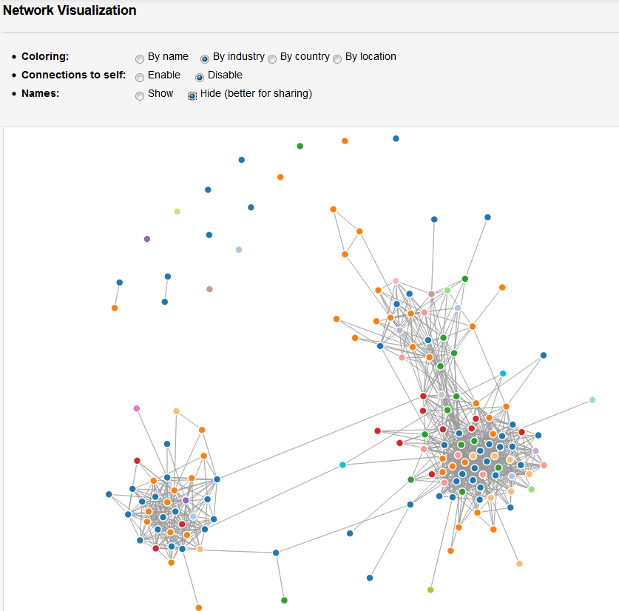
Exercise: LinkedIn Network Visualization and Analysis
Visualize and analyze your LinkedIn network
Go to http://socilab.com/#home
Sign in with your LinkedIn account
Once you explored your network visualization, check the corresponding metrics

Slide 42
Influencing Factors and Considerations
Formulating your brief
Timescale
Setting
Format
Purpose map
Working with Data
Data examination
Editorial Thinking
Angle, framing, focus
Data Representation
Chart type selection
Notes:
Kirk (2016) p238

Slide 43
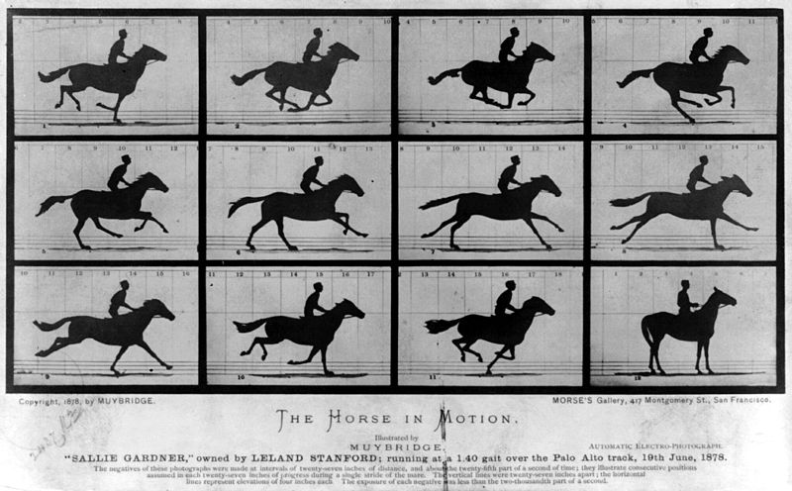
The Horse in Motion
x
Source: https://en.wikipedia.org/wiki/File:The_Horse_in_Motion.jpg
Notes:
Comparison of one moment with another; one approach: use small multiples -- repeat the same representation for each moment in time, and present all of them in one single view

Slide 44
Influencing Factors and Considerations (cont.)
Principle 1
Good data visualization is TRUSTWORTHY
Trustworthy Design
Functional Performance
Acessible Design
Useful
Unobtrusive
Visual accessibility
Elegant Design
Feature creep
Minimise the clicks
Fun
Principle 2
Good data visualization is ACCESSIBLE
Principle 3
Good data visualization is ELEGANT

Slide 45








Exercise – Higher Education Infographic
Prepare an infographic to illustrate information on Higher Education Undergraduate Graduates by Level and Field of Study (HEA data) for the seven Universities in Ireland
Select data from:
http://www.hea.ie/sites/default/files/awards_-_all_undergraduate_by_level_and_field.xlsx
Use infogram: https://infogr.am/
“design and share interactive data visualizations”
Notes:
Undergraduate honours degrees, ord degrees, certs & diplomas, Foundation and Access awarded in Universities in the calendar Year 2014 by field of study (ISCED): full-time & part-time (including distance and e-learning)

Slide 46
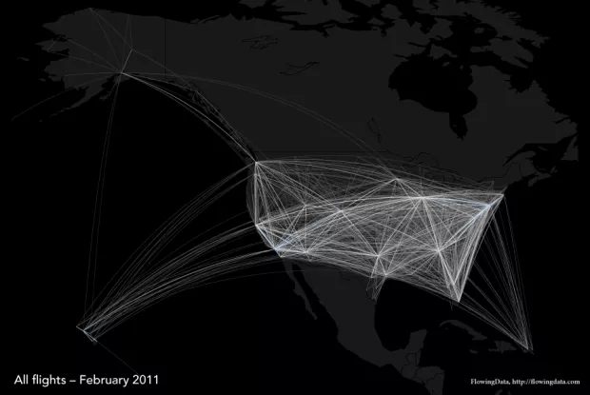
Mapping Exercise
Recall Some Do’s and Don’ts of Infographic Design (Yau, 2011)
Do…
analyze and understand the data
Don’t…
sacrifice accuracy, clarity and ultimately, an interesting story just to make something look unique
Image source: http://flowingdata.com/2011/05/05/where-do-major-airlines-fly-in-the-united-states/
Notes:
Interesting to compare Amy Balliett:
https://www.smashingmagazine.com/2011/10/the-dos-and-donts-of-infographic-design/
With Nathan Yau’s response:
https://www.smashingmagazine.com/2011/10/the-dos-and-donts-of-infographic-design-revisited/

Slide 47
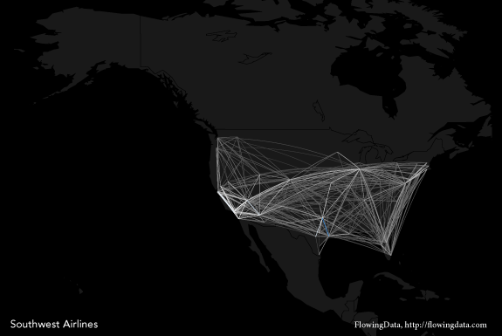
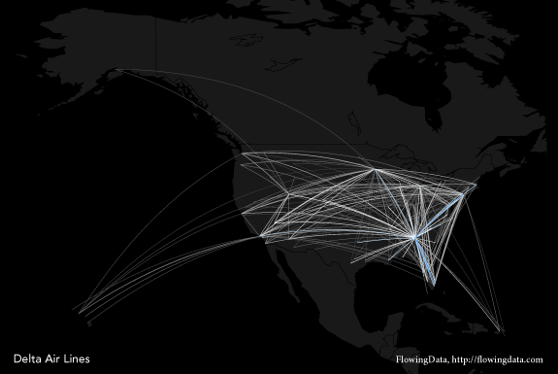
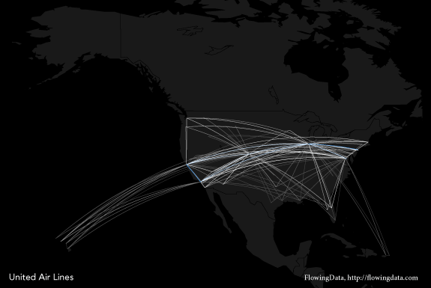
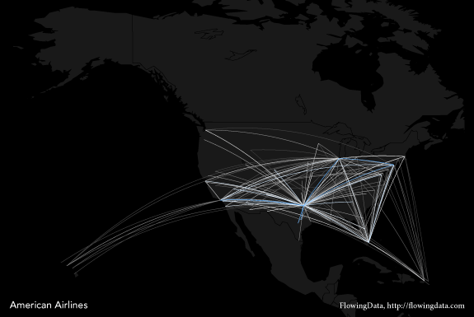
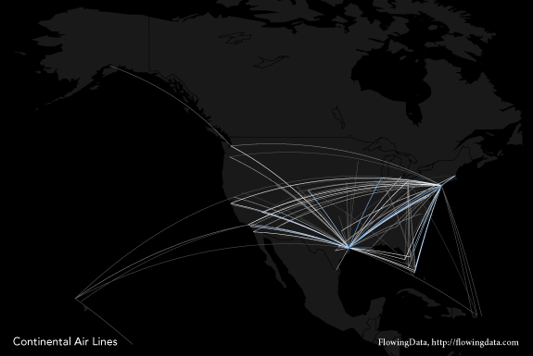
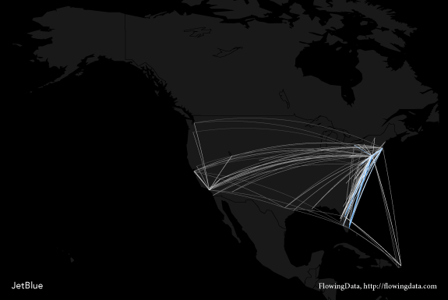
Design – Not Just About Making Things Pretty
Let data do the talking…
Notes:
Remember that design isn’t just about making things pretty. It’s about making things work, and in the case of infographics, that means representing data accurately and clearly. It means letting the data speak and not putting extraneous icons all over the place to obscure what’s important.

Slide 48
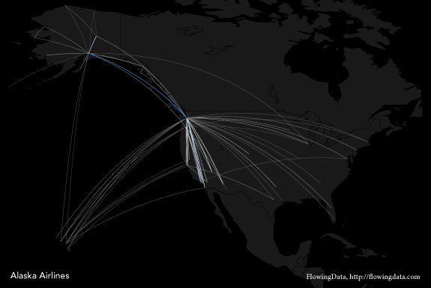
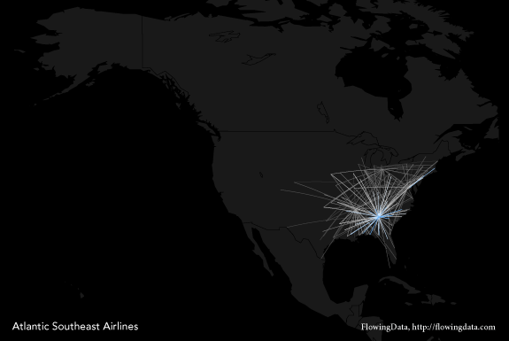
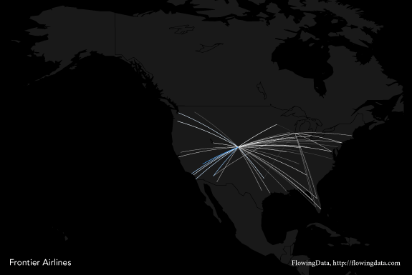
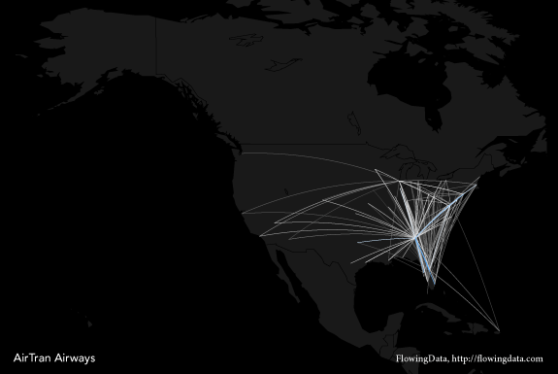
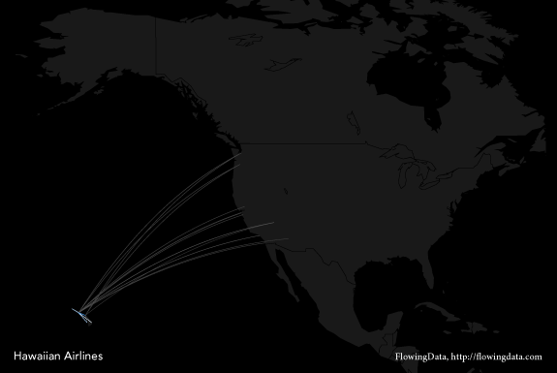
Design – Not Just About Making Things Pretty
Let data do the talking…
Notes:
Remember that design isn’t just about making things pretty. It’s about making things work, and in the case of infographics, that means representing data accurately and clearly. It means letting the data speak and not putting extraneous icons all over the place to obscure what’s important.

Slide 49
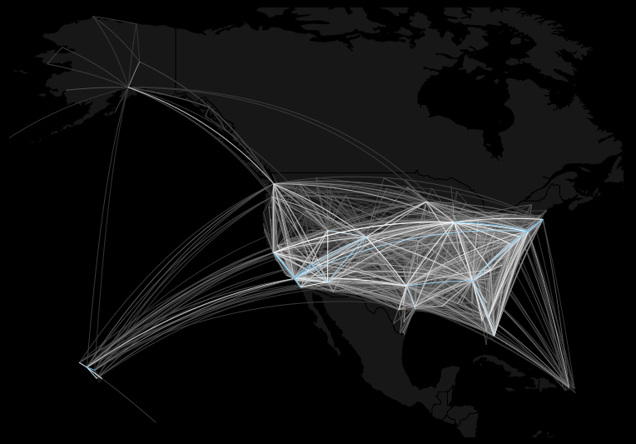
Create Map Connections
R script in Moodle to create previous flight data diagrams
How to map connections with great circles
Saves diagrams to PDF format in Working Directory
Notes:
#
# Example taken from: http://flowingdata.com/2011/05/11/how-to-map-connections-with-great-circles/
#
library(maps)
library(geosphere)
#
map("state")
map("world")
#
# Limiting boundaries
xlim <- c(-171.738281, -56.601563)
ylim <- c(12.039321, 71.856229)
map("world", col="#f2f2f2", fill=TRUE, bg="white", lwd=0.05, xlim=xlim, ylim=ylim)
#
# Draw connecting lines - draws a great circle arc from California to Maine.
lat_ca <- 39.164141
lon_ca <- -121.640625
lat_me <- 45.213004
lon_me <- -68.906250
inter <- gcIntermediate(c(lon_ca, lat_ca), c(lon_me, lat_me), n=50, addStartEnd=TRUE)
lines(inter)
#
# Draw line CA to TX
lat_tx <- 29.954935
lon_tx <- -98.701172
inter2 <- gcIntermediate(c(lon_ca, lat_ca), c(lon_tx, lat_tx), n=50, addStartEnd=TRUE)
lines(inter2, col="red")
#
# Load flight data
airports <- read.csv("http://datasets.flowingdata.com/tuts/maparcs/airports.csv", header=TRUE)
flights <- read.csv("http://datasets.flowingdata.com/tuts/maparcs/flights.csv", header=TRUE, as.is=TRUE)
#
# Draw multiple connections
map("world", col="#f2f2f2", fill=TRUE, bg="white", lwd=0.05, xlim=xlim, ylim=ylim)
fsub <- flights[flights$airline == "AA",]
for (j in 1:length(fsub$airline)) {
air1 <- airports[airports$iata == fsub[j,]$airport1,]
air2 <- airports[airports$iata == fsub[j,]$airport2,]
inter <- gcIntermediate(c(air1[1,]$long, air1[1,]$lat), c(air2[1,]$long, air2[1,]$lat), n=100, addStartEnd=TRUE)
lines(inter, col="black", lwd=0.8)
}
#
# Color for clarity
pal <- colorRampPalette(c("#f2f2f2", "black"))
colors <- pal(100)
map("world", col="#f2f2f2", fill=TRUE, bg="white", lwd=0.05, xlim=xlim, ylim=ylim)
fsub <- flights[flights$airline == "AA",]
maxcnt <- max(fsub$cnt)
for (j in 1:length(fsub$airline)) {
air1 <- airports[airports$iata == fsub[j,]$airport1,]
air2 <- airports[airports$iata == fsub[j,]$airport2,]
inter <- gcIntermediate(c(air1[1,]$long, air1[1,]$lat), c(air2[1,]$long, air2[1,]$lat), n=100, addStartEnd=TRUE)
colindex <- round( (fsub[j,]$cnt / maxcnt) * length(colors) )
lines(inter, col=colors[colindex], lwd=0.8)
}
#
# order connection from least to greatest flight counts
pal <- colorRampPalette(c("#f2f2f2", "black"))
pal <- colorRampPalette(c("#f2f2f2", "red"))
colors <- pal(100)
map("world", col="#f2f2f2", fill=TRUE, bg="white", lwd=0.05, xlim=xlim, ylim=ylim)
fsub <- flights[flights$airline == "AA",]
fsub <- fsub[order(fsub$cnt),]
maxcnt <- max(fsub$cnt)
for (j in 1:length(fsub$airline)) {
air1 <- airports[airports$iata == fsub[j,]$airport1,]
air2 <- airports[airports$iata == fsub[j,]$airport2,]
inter <- gcIntermediate(c(air1[1,]$long, air1[1,]$lat), c(air2[1,]$long, air2[1,]$lat), n=100, addStartEnd=TRUE)
colindex <- round( (fsub[j,]$cnt / maxcnt) * length(colors) )
lines(inter, col=colors[colindex], lwd=0.8)
}
#
# Map every carrier
# Unique carriers
map("world", col="#f2f2f2", fill=TRUE, bg="white", lwd=0.05, xlim=xlim, ylim=ylim)
carriers <- unique(flights$airline)
carriers
# Color
pal <- colorRampPalette(c("#333333", "white", "#1292db"))
colors <- pal(100)
#
for (i in 1:length(carriers)) {
pdf(paste("carrier", carriers[i], ".pdf", sep=""), width=11, height=7)
map("world", col="#191919", fill=TRUE, bg="#000000", lwd=0.05, xlim=xlim, ylim=ylim)
fsub <- flights[flights$airline == carriers[i],]
fsub <- fsub[order(fsub$cnt),]
maxcnt <- max(fsub$cnt)
for (j in 1:length(fsub$airline)) {
air1 <- airports[airports$iata == fsub[j,]$airport1,]
air2 <- airports[airports$iata == fsub[j,]$airport2,]
inter <- gcIntermediate(c(air1[1,]$long, air1[1,]$lat), c(air2[1,]$long, air2[1,]$lat), n=100, addStartEnd=TRUE)
colindex <- round( (fsub[j,]$cnt / maxcnt) * length(colors) )
lines(inter, col=colors[colindex], lwd=0.6)
}
dev.off()
}

